Slide 1
Tax Classes and Transitional Assessment of Parcels with Capped Increases
New York City Department of Finance

Slide 2
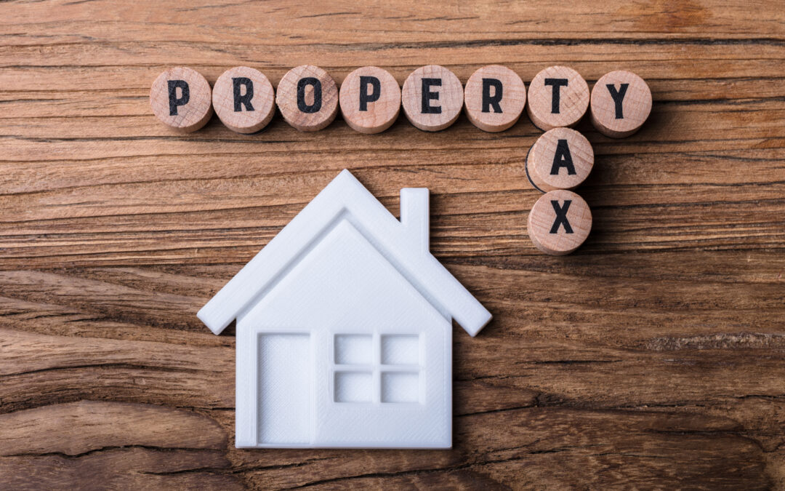
Topics covered in today’s discussion
Tax classes
Assessment ratios
The tax classes with a capped increase in taxable assessed value
Actual Assessed Value vs. Transitional Assessed Value
Equalization

Slide 3
Tax Classes
Description of tax classes and the property types associated with them

Slide 4
Tax Class 1
Comprised primarily of one to three family dwellings
Vacant land with residential zoning or in adjacent proximity to a Tax Class 1 property with the same ownership
Condominiums that meet the criteria to be categorized as Tax Class 1
Has a 6% assessment ratio
Tax classifications include:
1
1A
1B
1D

Slide 5
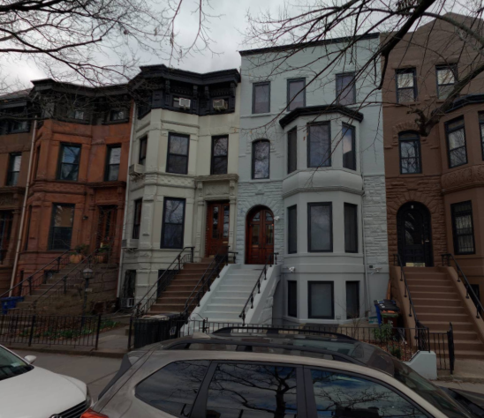
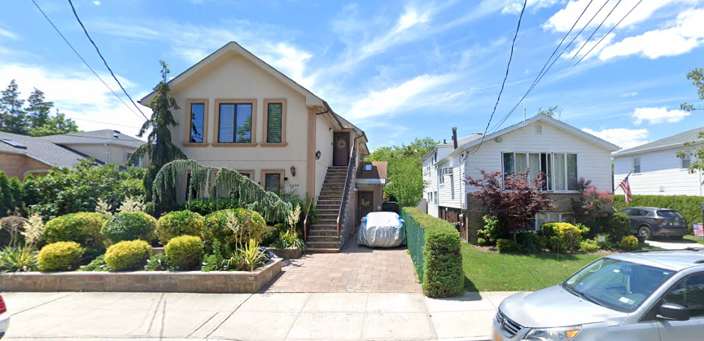
Tax Class 1 – One to three family dwellings

Slide 6
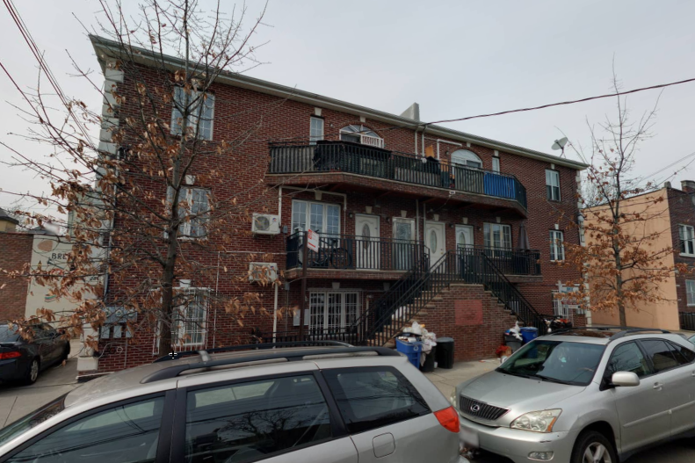
Tax Class 1A – 1 to 3 story condominium

Slide 7
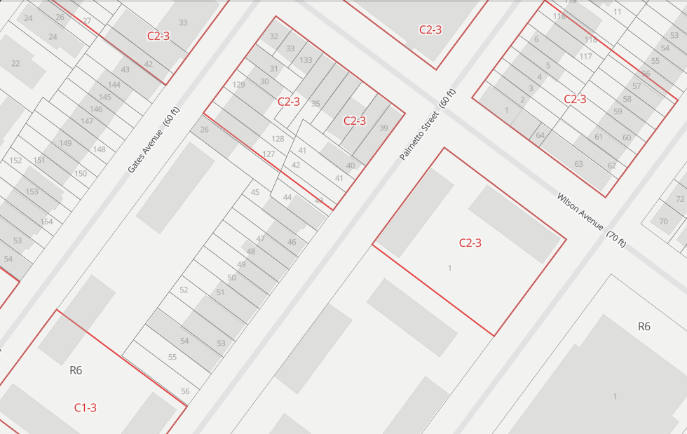
Tax Class 1B – Vacant land
V0 – Vacant land with residential zoning, not in Manhattan
V2 – Vacant land with commercial zoning that is adjacent to a Tax Class 1 parcel with the same owner for both lots
V3 – Vacant land zoned primarily residential, not in Manhattan
The map shows blocks in an R6 (residential) zone. The blue arrow is pointing at two vacant lots with no commercial overlay. The green arrow is pointing at three vacant lots, two of which are completely in the overlay and one with more than 50% in the overlay.

Slide 8
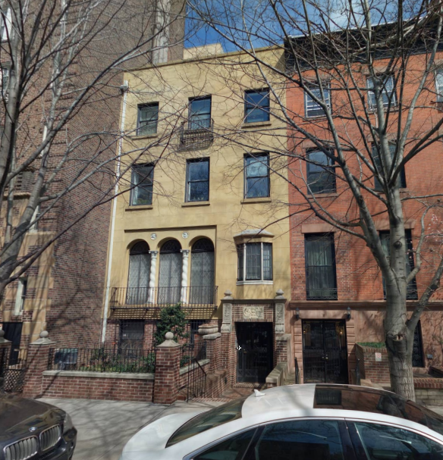
Tax Class 1C – 1-to-3-unit condominium that was originally a Tax Class 1
Cannot contain more than 3 units
The building must have been a Tax Class 1 property prior to converting into a condominium

Slide 9
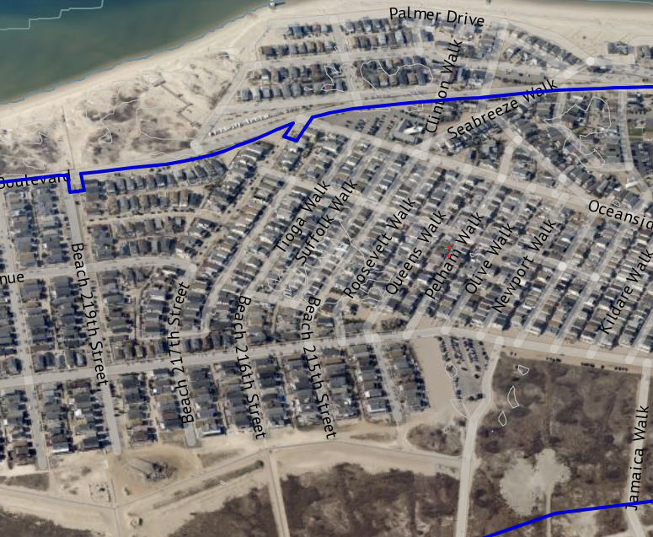
Tax Class 1D – Bungalow Colony
Breezy Point

Slide 10
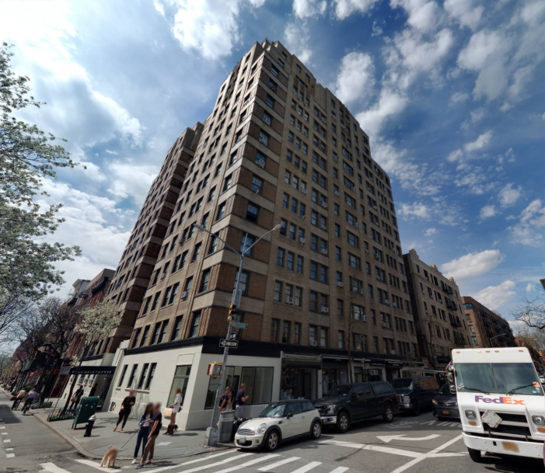
Tax Class 2
Properties that are predominantly residential in use with 4 or more units
Includes condominiums and cooperatives
Has a 45% assessment ratio
Tax Class 2 has three additional subcategories depending on unit count and use
Tax Class 2: predominantly residential with 11 or more units
Tax Class 2A: non-condo that is predominantly residential with 4-to-6 units
Tax Class 2B: non-condo that is predominantly residential with 7-to-10 units
Tax Class 2C: condo that has 2-to-10 units

Slide 11
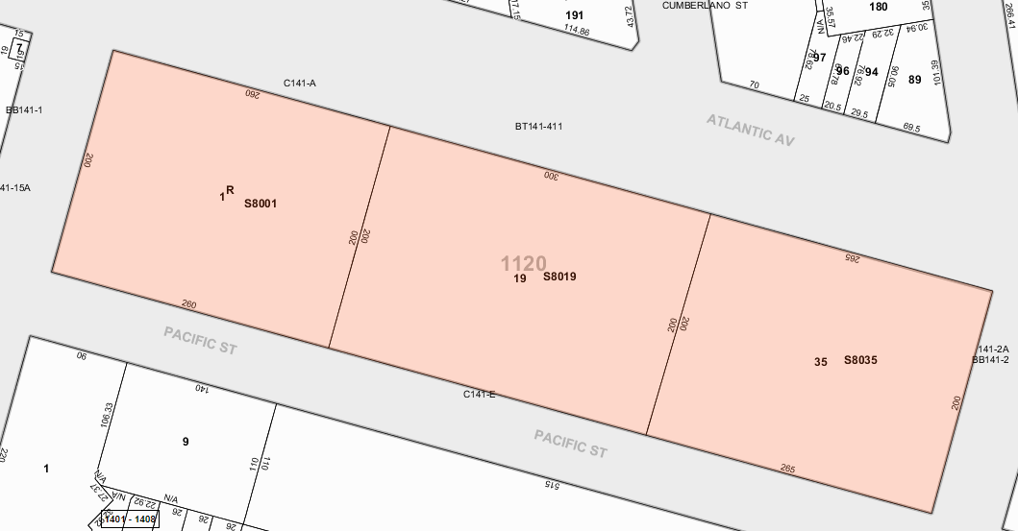
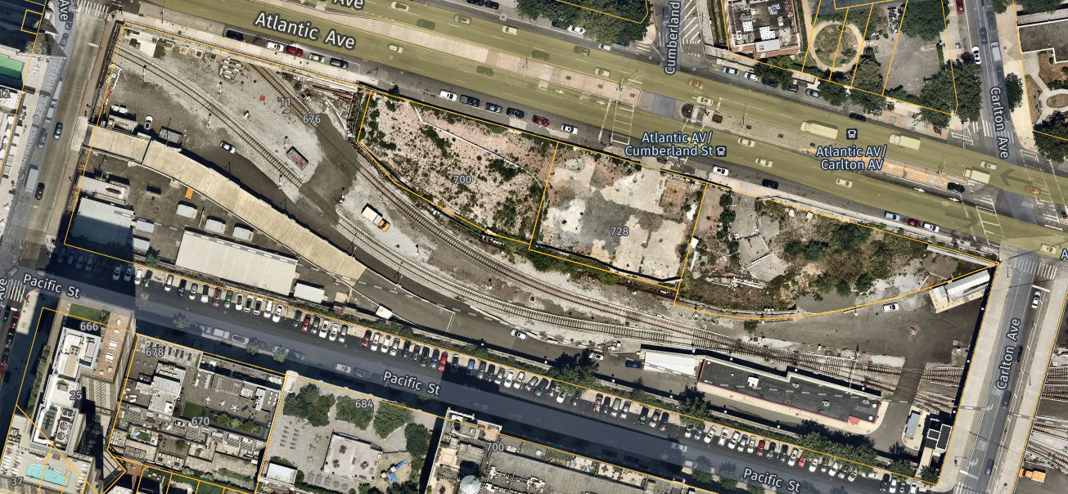
Tax Class 3 – Utility company equipment and special franchise property The Real Estate of Utility Companies (REUC) Unit are responsible for these parcels
The “R” indicates an REUC parcel, and the “S” indicates a subterranean parcel
LIRR

Slide 12

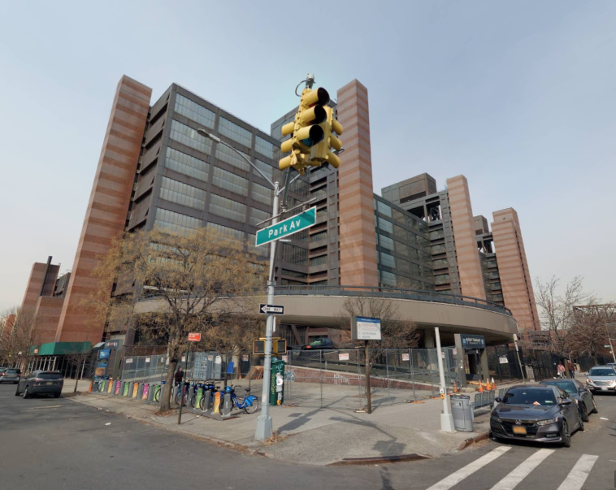
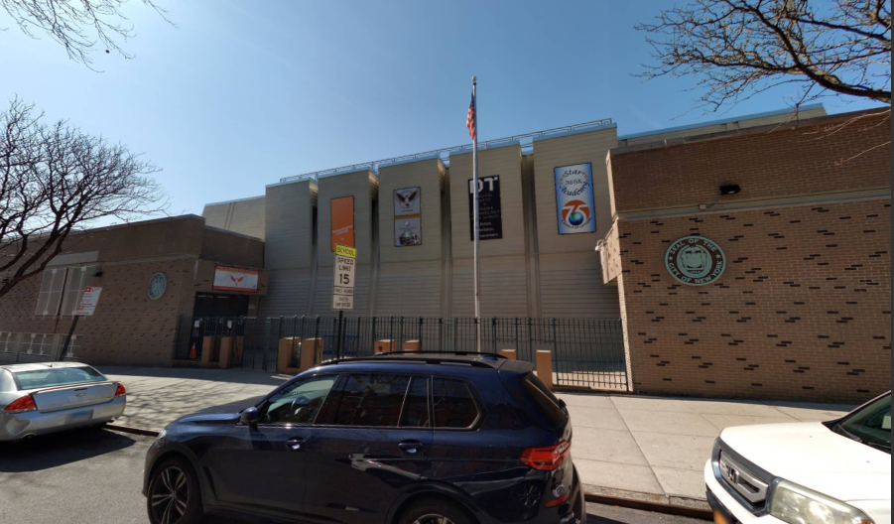
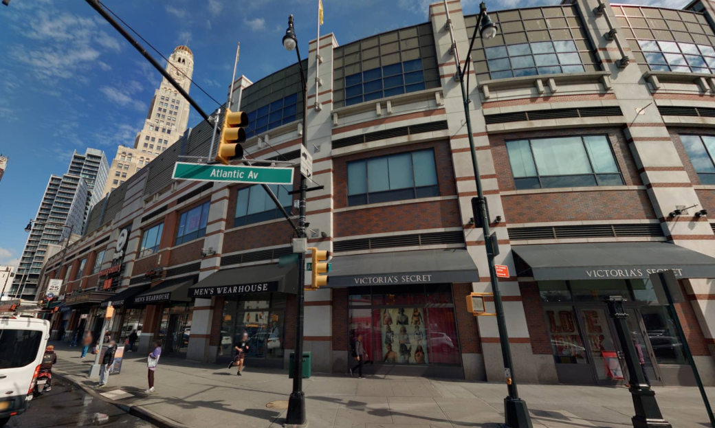
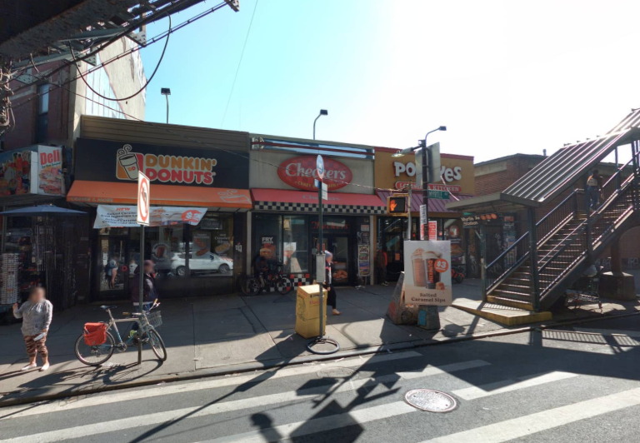
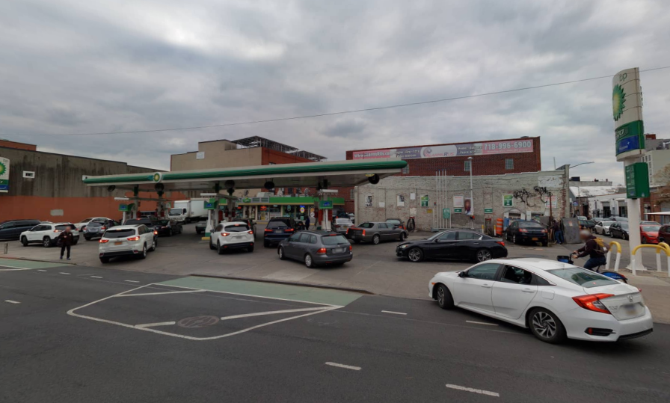
Tax Class 4 – all other uses including, but not limited to, offices, retail, industrial, hospitals, garages, etc. These parcels have a 45% assessment ratio

Slide 13
Assessment Ratios and Actual Assessed Value
How to calculate the Actual Assessed Value

Slide 14
Assessment Ratios and Actual Assessed Value
All Tax Class 1 parcels have a 6% assessment ratio
Market Value: $1,255,000
Assessment Ratio: 6%
Actual Assessed Value: $75,300
All other tax classes have a 45% assessment ratio
Market Value: $984,000
Assessment Ratio: 45%
Actual Assessed Value $442,800

Slide 15
Capped increase in Taxable Assessed Value
RPTL § 1805

Slide 16
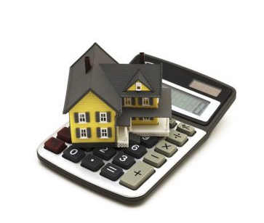
RPTL § 1805 as applied to Tax Class 1, 1A, 1B, 1C, and 1D – The “6-20” rule
The assessor of any special assessing unit shall not increase the assessment of any individual parcel classified in class one in any one year, as measured from the assessment on the previous year's assessment roll, by more than six percent and shall not increase such assessment by more than twenty percent in any five-year period.

Slide 17

RPTL § 1805 as applied to Tax Class 2A, 2B, and 2C – The “8-30” rule
The assessment roll of a special assessing unit wholly contained within a city shall identify those parcels classified in class two which have fewer than eleven units. The assessor of any such special assessing unit shall not increase the assessment of any parcel so identified in any one year, as measured from the actual assessment on the previous year's assessment roll, by more than eight percent and shall not increase such assessment by more than thirty percent in any five-year period.

Slide 18
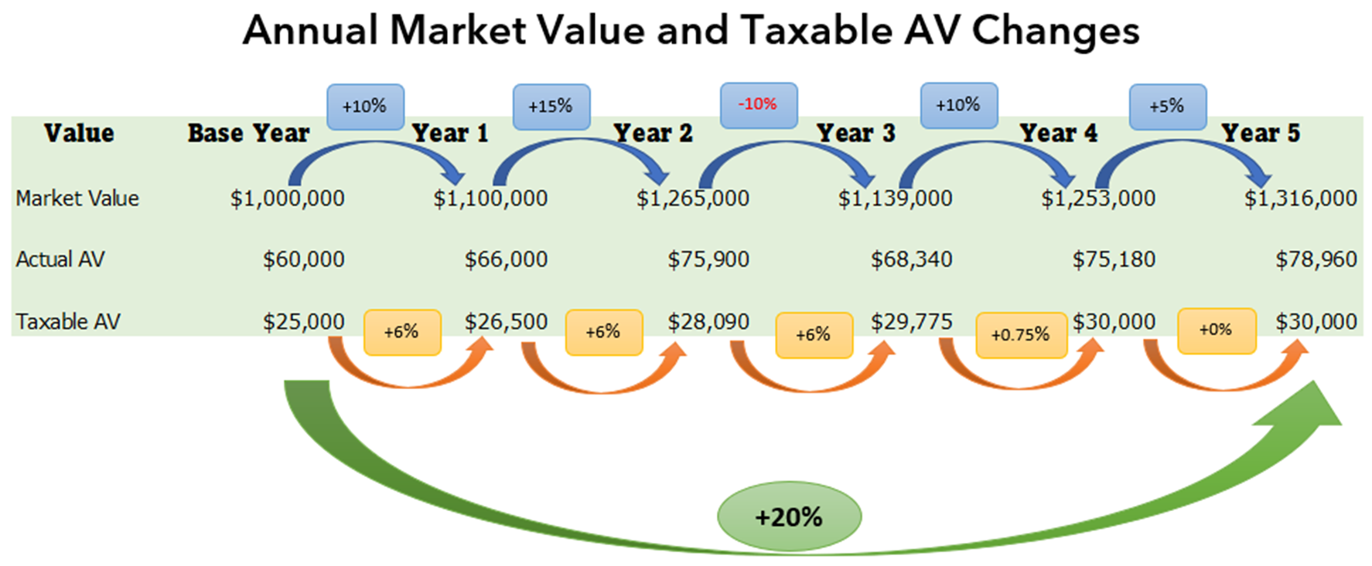
Tax Class 1 five-year schedule with no physical changes or changes in equalization

Slide 19
Physical / Quantity Changes
Increases
New Construction
New Addition
Improvements/Renovation
Partial Construction
New Equipment
Placement of Mobile Home
Omitted Property
Land Gains
Land Annexed
Tax Map Revision
Increased Production of Oil & Gas Rights
Decreases
Demolition
Fire
Removed Equipment
Removal of Mobile Home
Duplicated or Erroneous Parcels
Land Losses
Land Deeded
Tax Map Revision
Decreased Production of Oil and Gas rights

Slide 20
Equalization Changes
Revaluation
Adjustment for Equity
Change in Zoning
Change in Land Use
Appreciation
Depreciation
Economic Obsolescence
Change in Income Stream
Court Ordered Reduction
Apportionments & Mergers

Slide 21
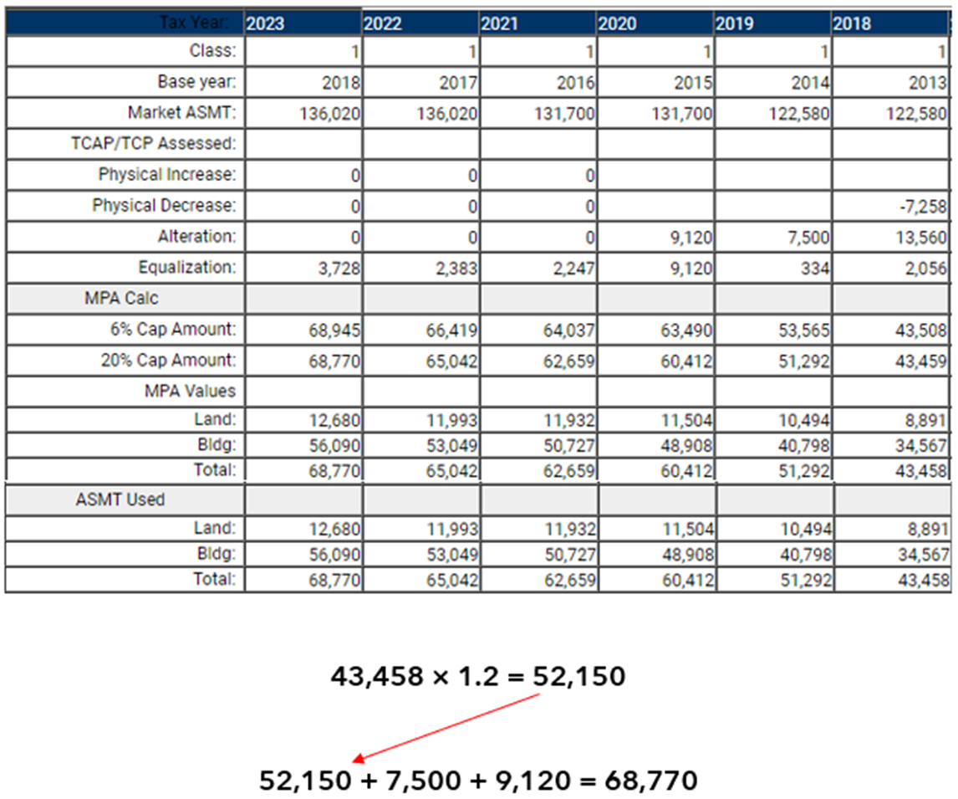

Tax Class 1 five-year schedule with two physical increases after the base year

Slide 22
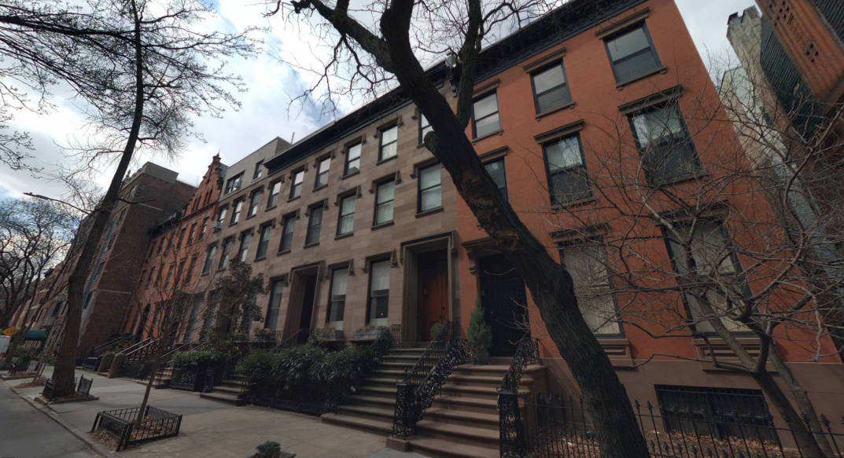
Questions? Comments?

